Slide 1
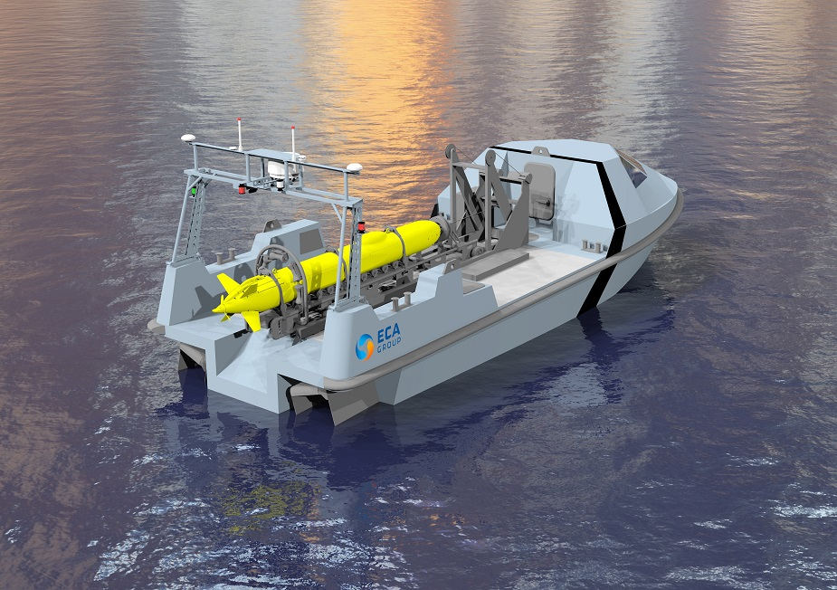
Progress Report USV Control System
Image from Naval Recognition
Notes:
Cover & End Slide Option
Replace the background image: Right-click on the slide, then choose Format Background and select Picture or texture fill. Select a new picture of your choice.
Remember to add an image attribution for e.g., Photo by Stefan Els.

Slide 2
Background
USV
Unmanned Surface Vessel.
Independent Control.
Autonomous Steering.
Obstacle Avoidance.
Active Positioning Knowledge.
Off-site Control.
Open Communication Connection.

Slide 3
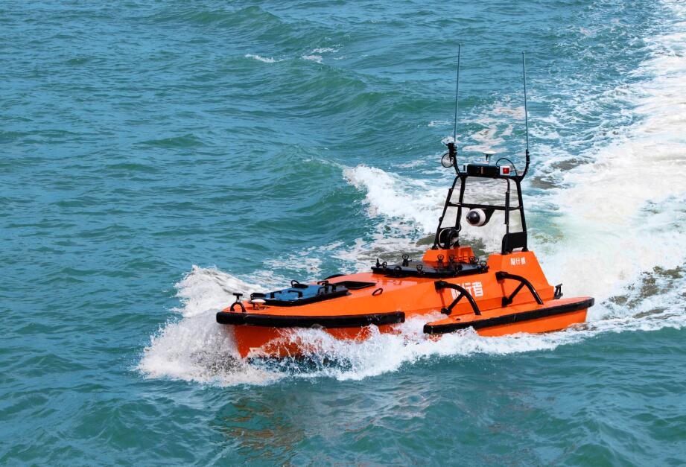
Background
Motivation
Military.
Patrolling.
Fire Support.
Research.
Marine Surveying.
Rescue.
Remote Response Time.
Image from OceanAlpha

Slide 4
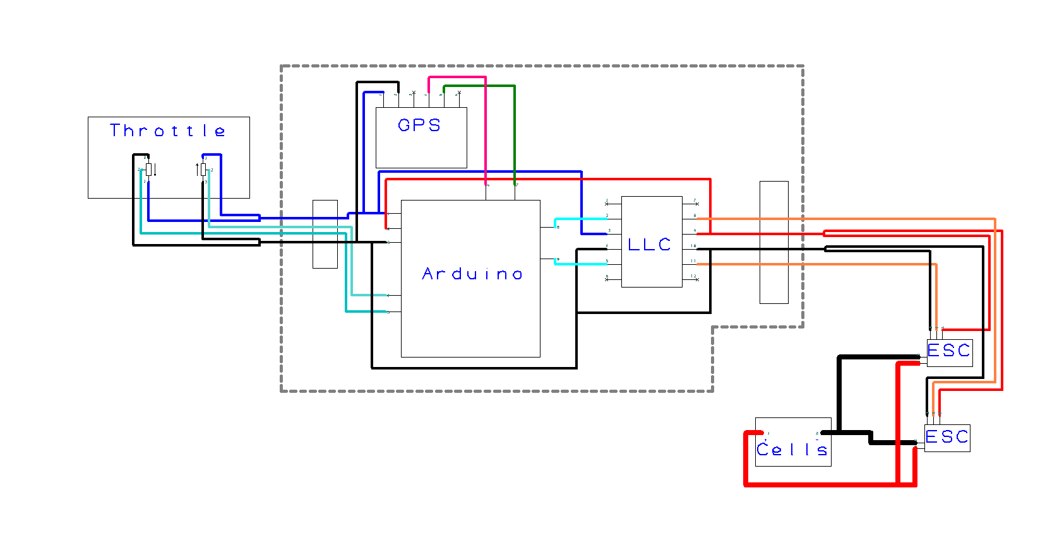
System Schematic
Image from Naval Recognition
Notes:
Cover & End Slide Option
Replace the background image: Right-click on the slide, then choose Format Background and select Picture or texture fill. Select a new picture of your choice.
Remember to add an image attribution for e.g., Photo by Stefan Els.

Slide 5
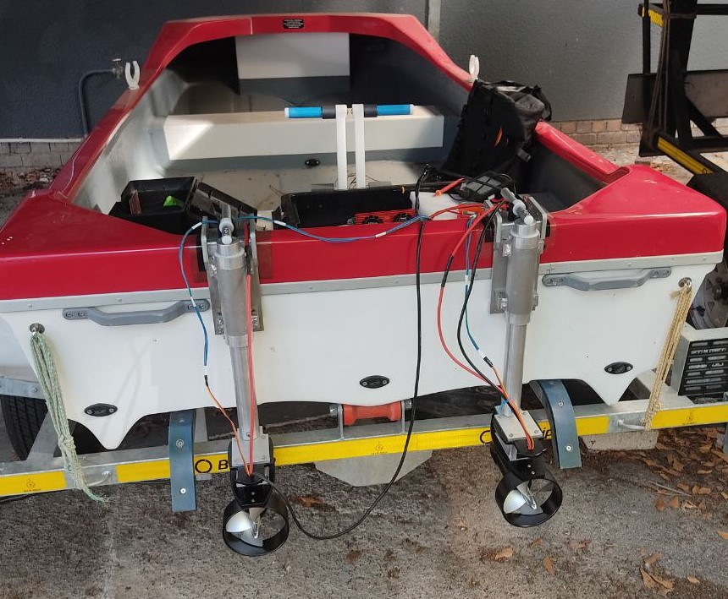
Progress
System Description
Spider 3 Boat.
TD20 Thrusters & ESC.
12V LiFePO4 Battery.
Arduino DUE Microcontroller.
PMOD GPS Module.
Photo by Luke Kingwill

Slide 6
Progress
Hardware
Motor Mounts.
Throttle Assembly.
Trailer License.
PCB Board.
Soldering.
Notes:
Add Picture of the throttle.

Slide 7
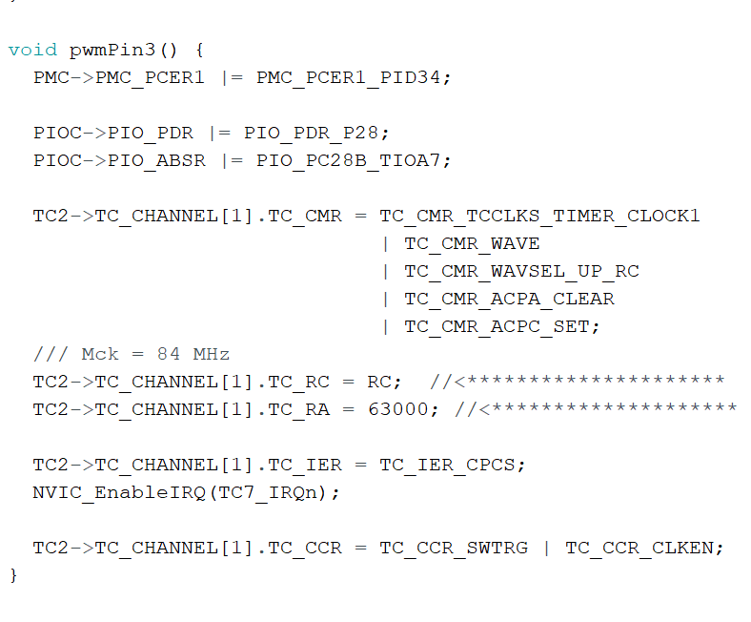
Progress
Software
Analog Read.
Adjust Timer Frequency.
Adjust Timer Duty Cycle.
Manual Control Implemented.
Receive GPS Data.

Slide 8
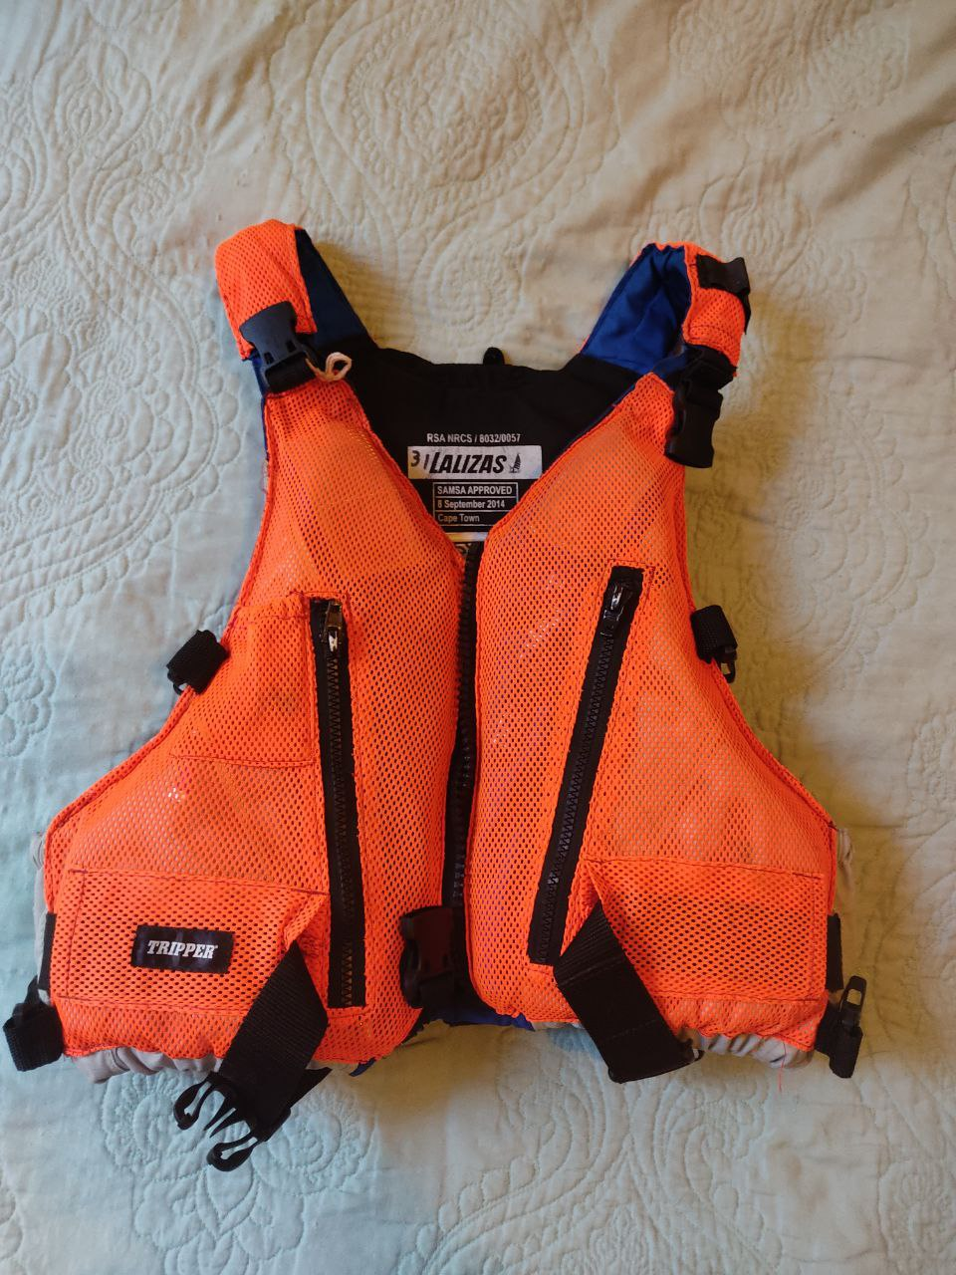
Planning
Safety
Lifejackets Worn While on the Boat.
Boat Never Unmanned.
Emergency Cut Off Switch.
Electrical Fire Extinguisher.
Water Proofing Electronics.
Photo by Luke Kingwill

Slide 9
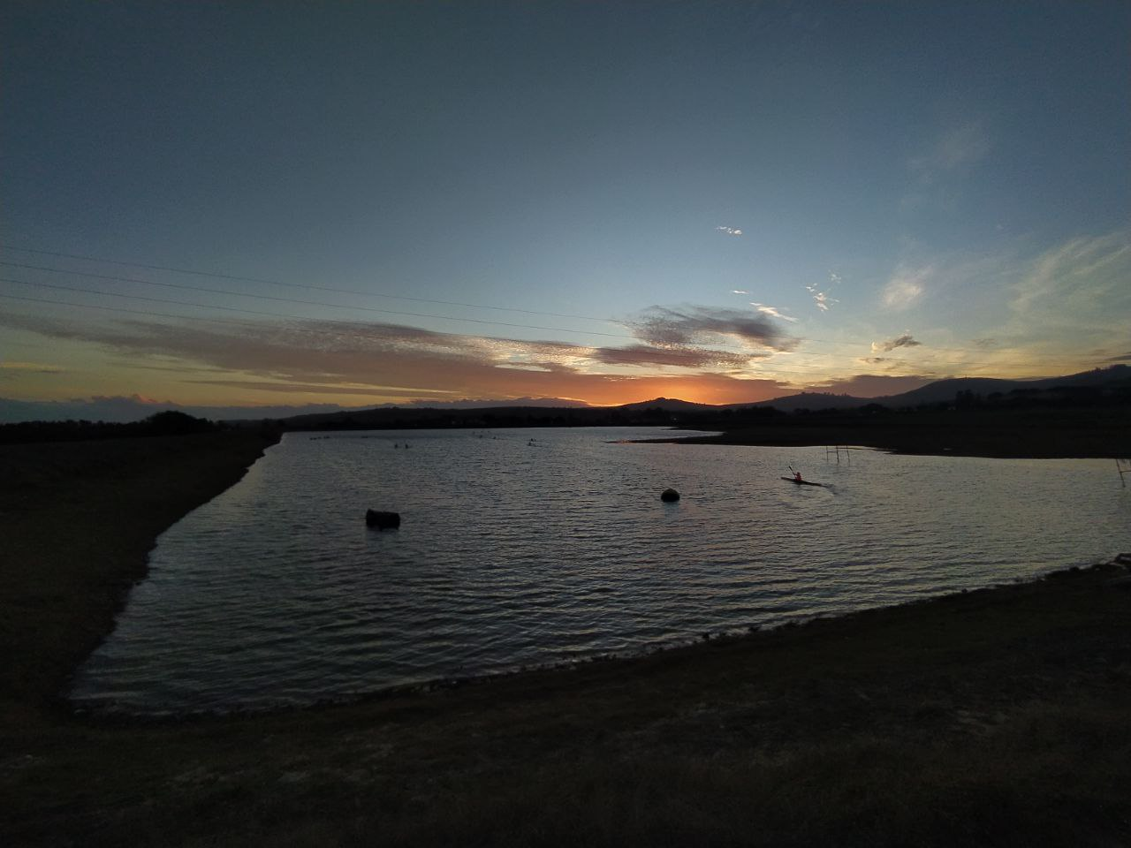
Planning
Testing
Power Test Scheduled.
Small Tests – Maties Canoe Club.
Large Tests – Theewaterskloof Dam
Photo by Rob Pike

Slide 10
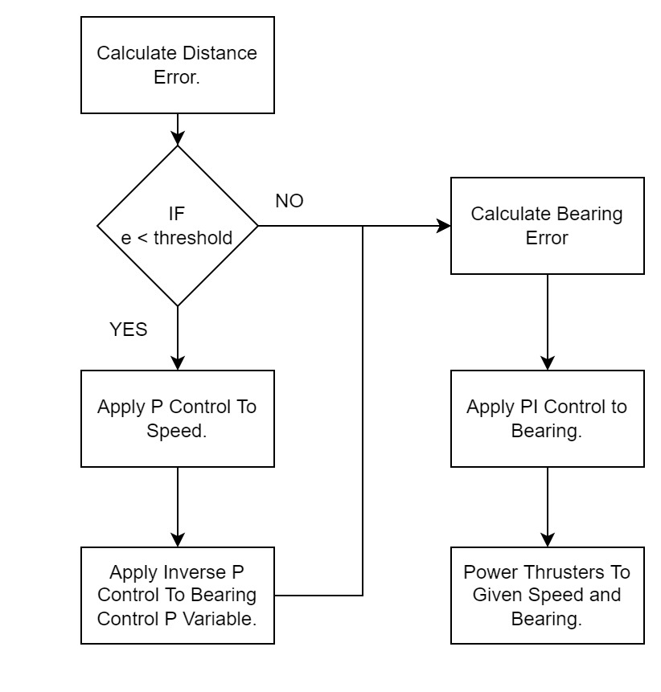
Planning
Autonomous Control
Given Set Points.
PI Control Steering.
P Control Thrust.

Slide 11
Planning
Budget
Description | Quantity | Item Cost | Total Cost
Spider 3 Boat & Trailer | 1 | R 16 000 | R 16 000
TD20 Thruster & ESC | 2 | R 6 500 | R 16 500*
12V Battery System | 1 | R 10 000 | R 10 000**
Arduino | 1 | R 590 | R 590
GPS Module | 1 | R 670 | R 670
Consumables | NA | R 2 000 | R 2 000
Travel | 4 | R 950 | R 3 800
 |  |  | R 49 560
*An extra ESC was ordered to replace the damaged one.
**A request for a quote has been sent to upgrade the batteries for more power.
Notes:
Driving = 150km per trip @ R3.00 per km = R450 per trip
Accom = R500 per night
Total Travel = R 950 per trip

Slide 12
Conclusion
Most of the Hardware is Complete.
The Manual Control is Operational.
Power Test Scheduled.
Autonomous Control to be Implemented.
Testing at Theewaterskloof Dam.
Notes:
Driving = 150km per trip @ R3.00 per km = R450 per trip
Accom = R500 per night
Total Travel = R 950 per trip

Slide 13
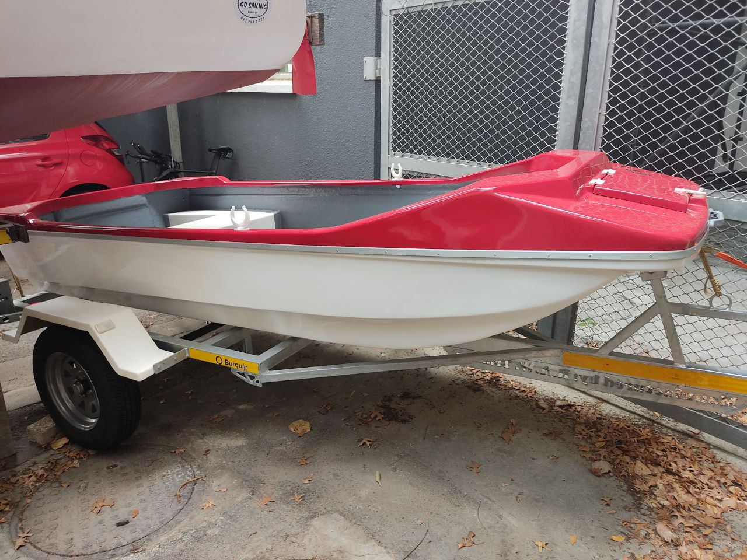
Thank you
Enkosi
Dankie
Photo by Luke Kingwill
Notes:
Cover & End Slide Option
Replace the background image: Right-click on the slide, then choose Format Background and select Picture or texture fill. Select a new picture of your choice.
Remember to add an image attribution for e.g., Photo by Stefan Els.

